Slide 1
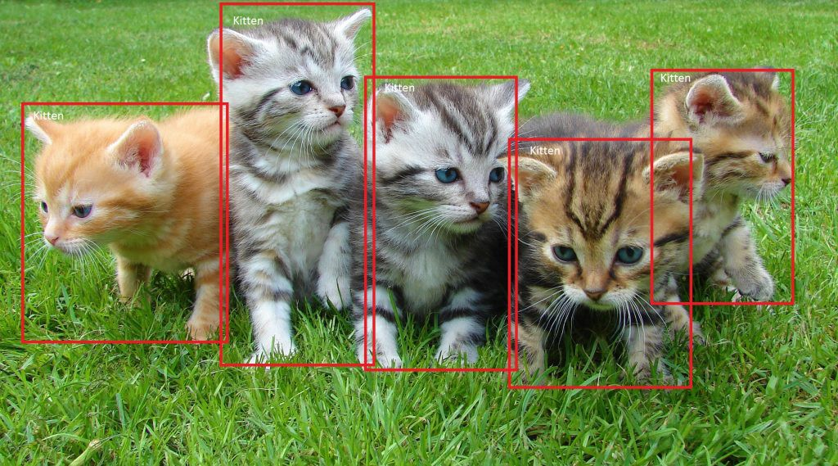
SSD: Single Shot MultiBox Detector 29 Dec 2016 UNC Chapel Hill, Zoox Inc., Google Inc. and University of Michigan, Ann-Arbor
Daniel Kovachev & Yuval Amrami
Example of end-to-end object detection in a Box (from Microsoft)

Slide 2
Problem Definition
Given an image as input
Predict bounding boxes and class labels for each object in the image.
Object Detection

Slide 3
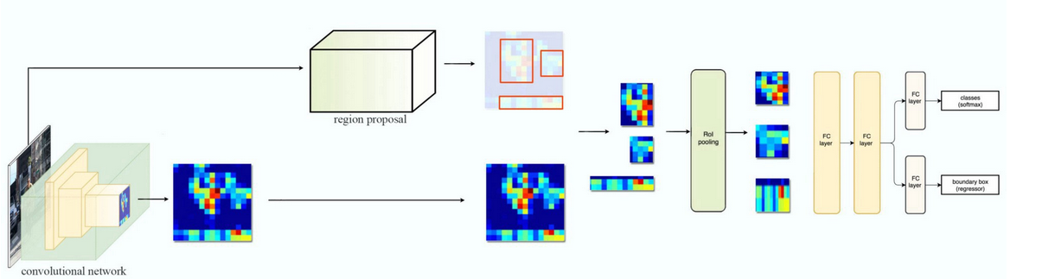
Fast R-CNN

Slide 4
Fast R-CNN Problems
Training phase is too long
Training happens in multiple phases (e.g. training region proposal vs classifier)
Network is too slow at inference time(2 seconds)

Slide 5
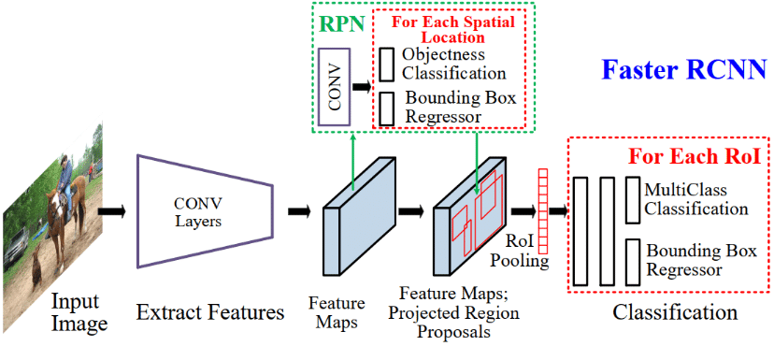
Faster R-CNN

Slide 6
Faster R-CNN Problems
Training phase is too long
Network is too slow at inference time (0.2 seconds)

Slide 7
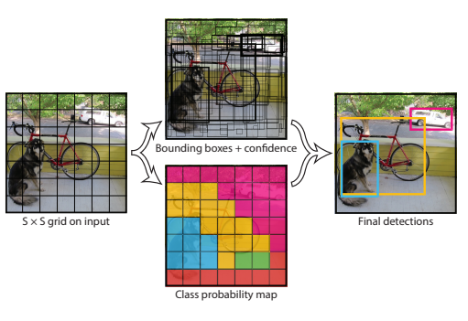
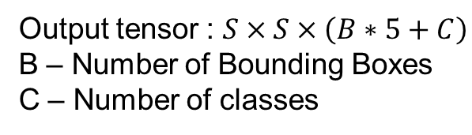
YOLO – You Only Look Once
Output tensor : $S×S×\left(B∗5+C\right)$
B – Number of Bounding Boxes
C – Number of classes

Slide 8
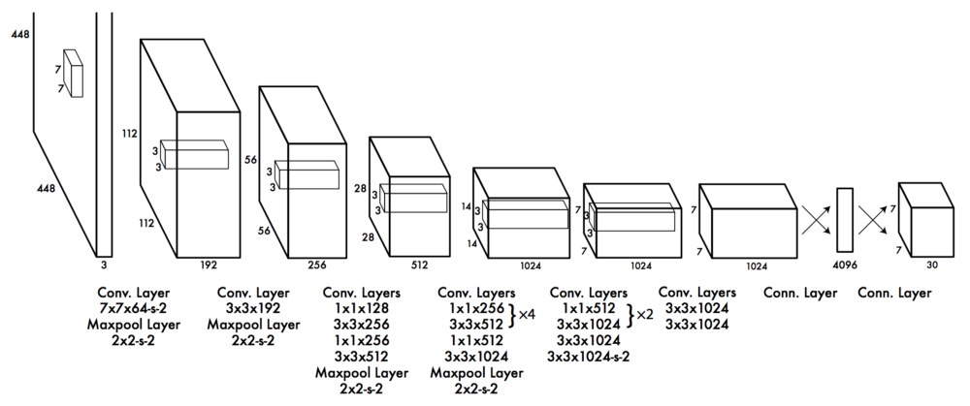
YOLO – You Only Look Once

Slide 9
YOLO Problems
Low Accuracy compared to Faster R-CNN.
Struggle with small objects.

Slide 10
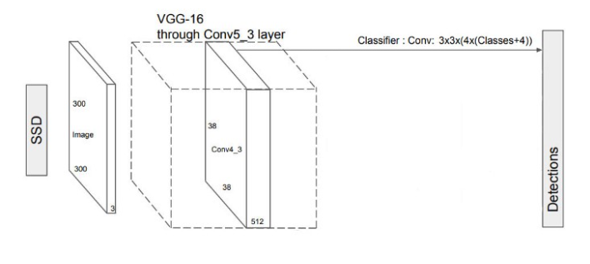
Single Shot MultiBox Detector
extract features
predict class probabilities & bounding boxes location

Slide 11
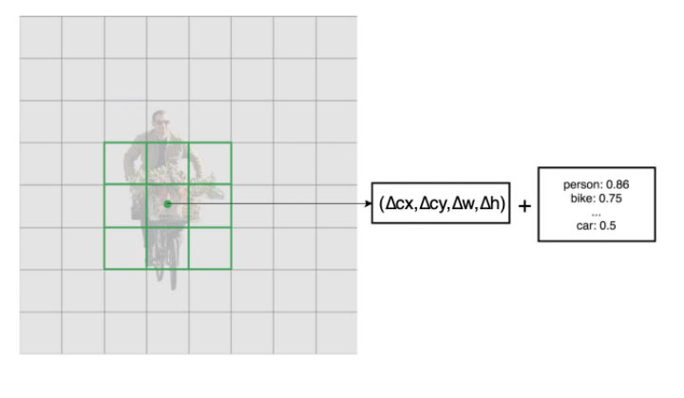
Single Shot MultiBox Detector
output prediction (C + 4)*B
each conv layer output M*N*B*(C+4)

Slide 12
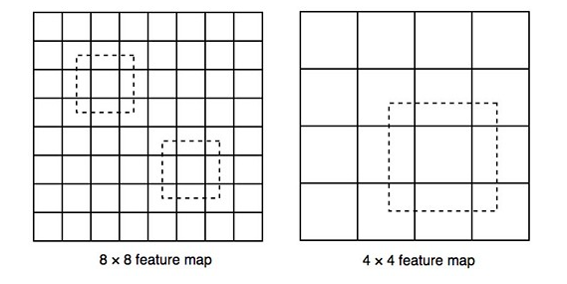
Single Shot MultiBox Detector
bigger feature maps detect smaller objects
Smaller feature maps detect bigger objects

Slide 13
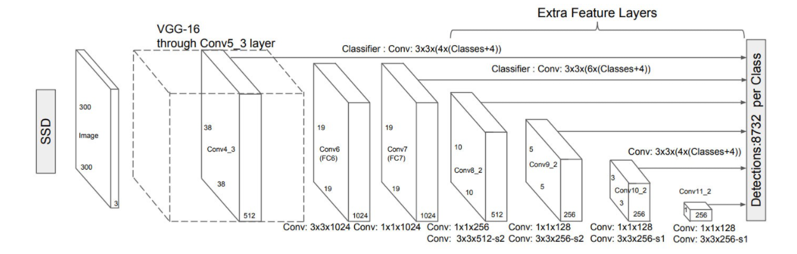
Single Shot MultiBox Detector

Slide 14
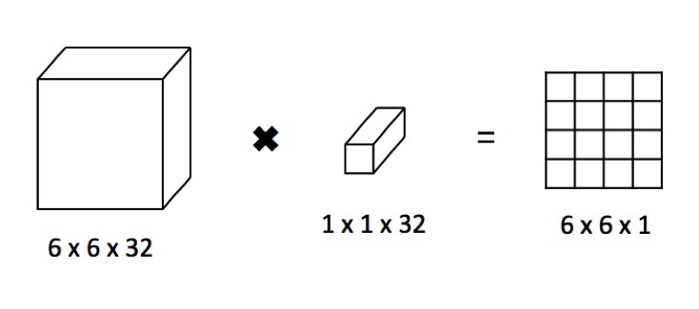
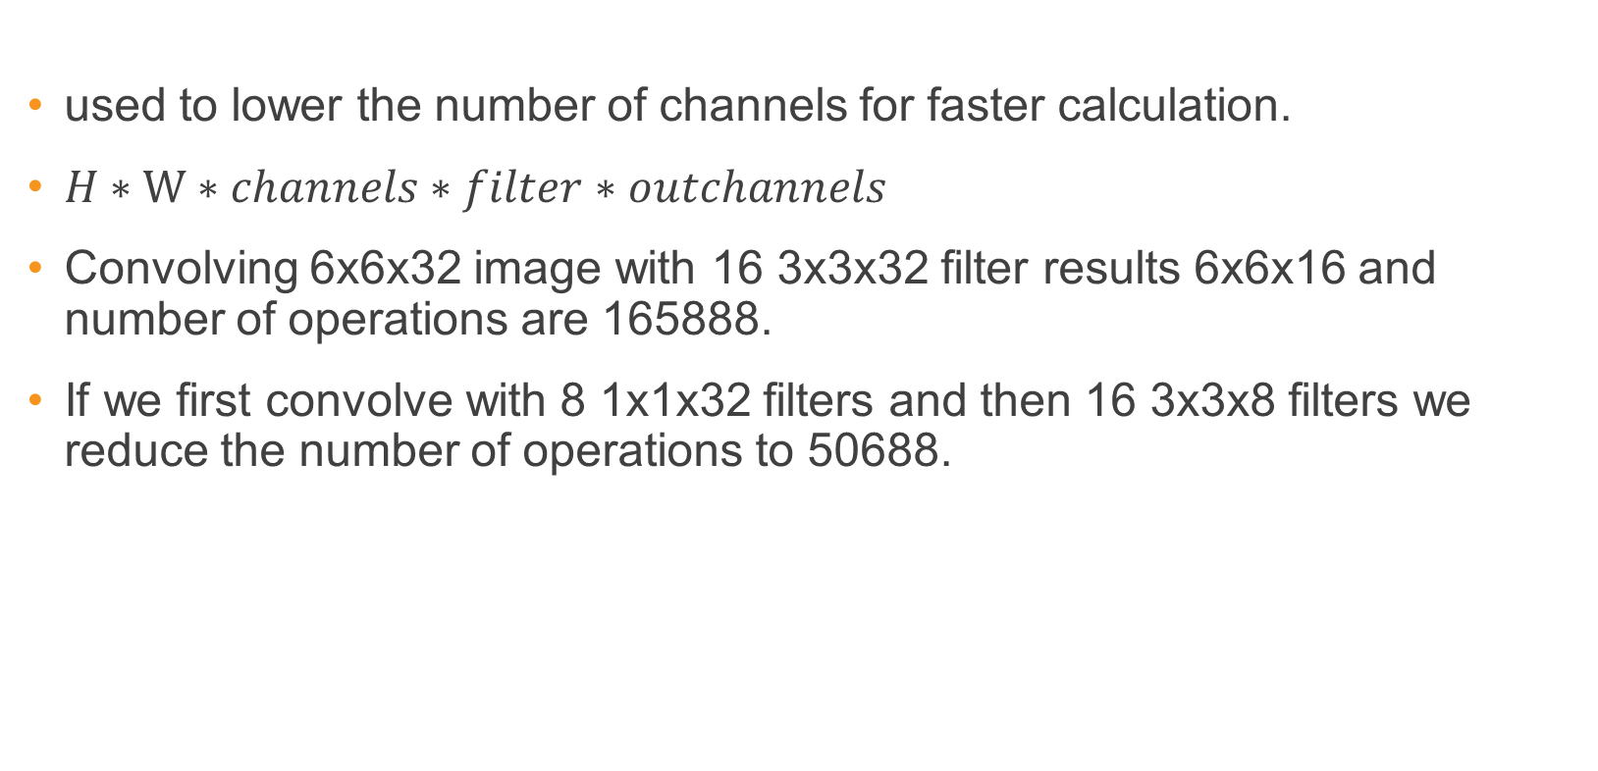
1x1 conv layer
used to lower the number of channels for faster calculation.
$H∗W∗channels∗filter∗outchannels$
Convolving 6x6x32 image with 16 3x3x32 filter results 6x6x16 and number of operations are 165888.
If we first convolve with 8 1x1x32 filters and then 16 3x3x8 filters we reduce the number of operations to 50688.

Slide 15
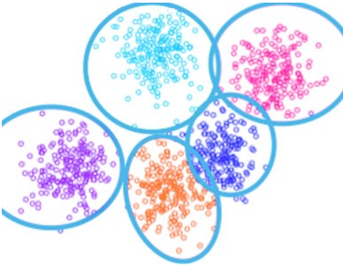
Choosing Bounding Boxes
Previous model try to predict different types of bounding boxes
Empirical results indicate early training can be very unstable.
Bounding boxes do not have arbitrary shapes.

Slide 16
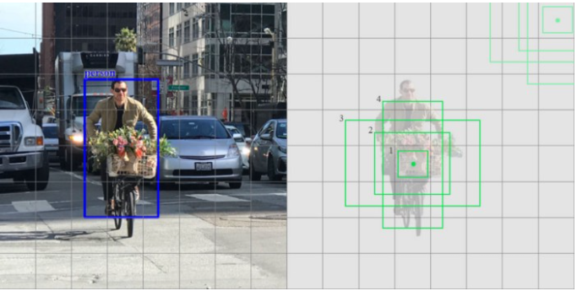
Choosing Bounding Boxes
SSD default boxes are selected manually.
Keeps complexity low and help with training.
SSD also keeps the default boxes to a minimum (4 or 6) with one prediction per default box.

Slide 17
Bounding Boxes Scales

Slide 18
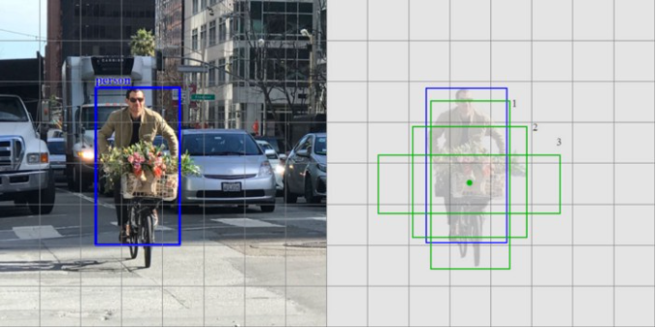
Matching Strategy
SSD predictions are classified as positive matches or negative matches
If the corresponding default boundary box (not the predicted boundary box) has an IoU greater than 0.5 with the ground truth, the match is positive
This processes is repeated for different scales

Slide 19
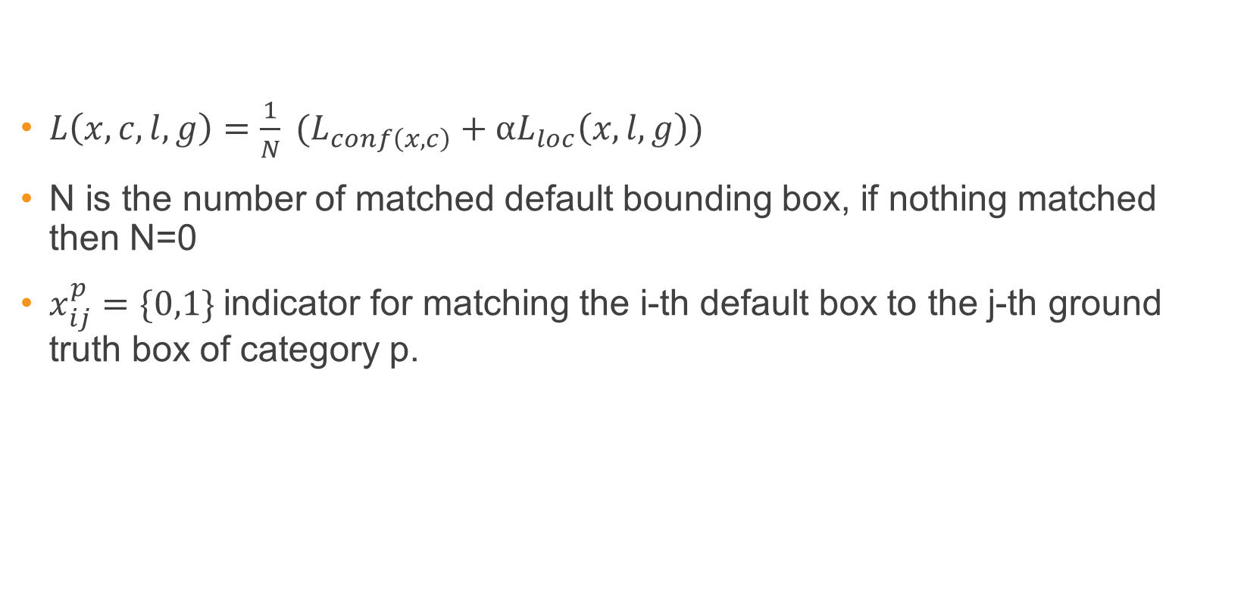
Loss Function
$L\left(x,c,l,g\right)=\frac{1}{N} (L_{conf\left(x,c\right)}+αL_{loc}\left(x,l,g\right))$
N is the number of matched default bounding box, if nothing matched then N=0
$x_{ij}^{p}=\{0,1\}$ indicator for matching the i-th default box to the j-th ground truth box of category p.

Slide 20
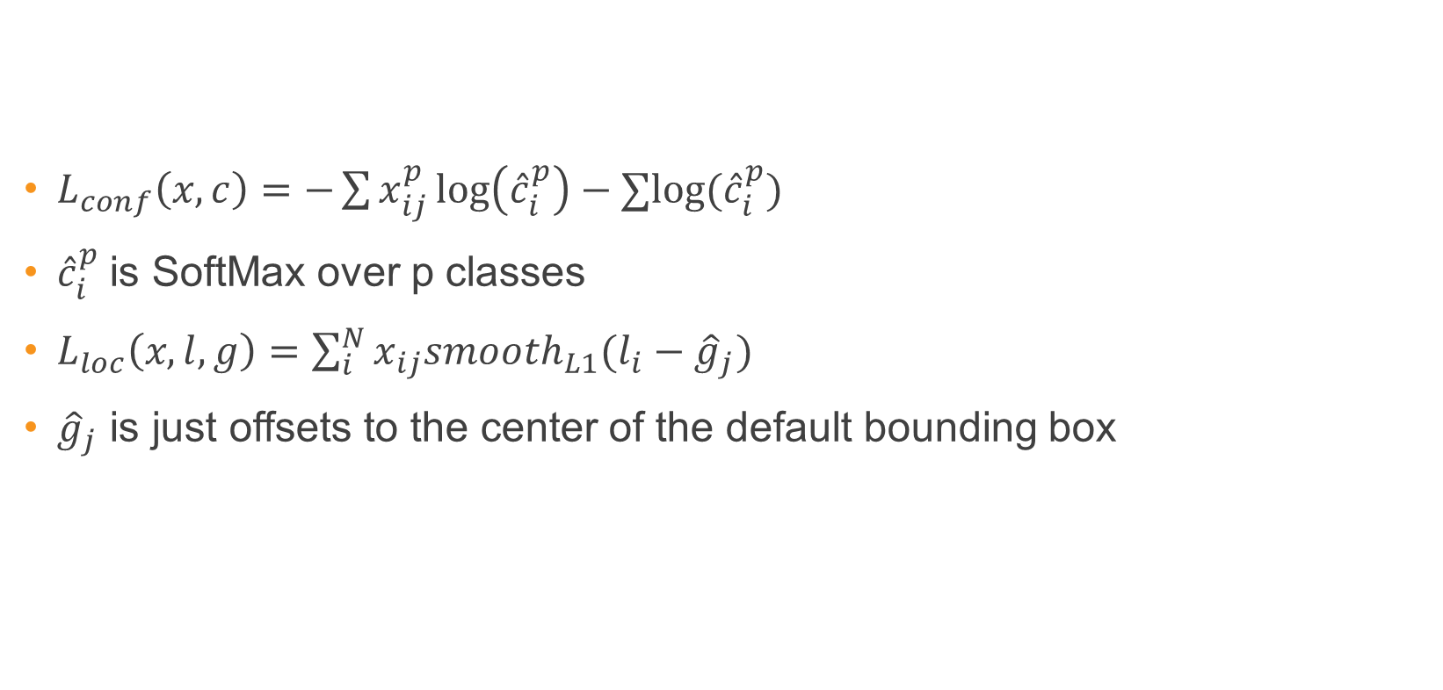
Loss Function
$L_{conf}\left(x,c\right)=−\sum{x_{ij}^{p}\log\left({\hat{c}}_{i}^{p}\right)−∑log⁡({\hat{c}}_{i}^{p})}$
${\hat{c}}_{i}^{p}$ is SoftMax over p classes
$L_{loc}\left(x,l,g\right)=\sum_{i}^{N}{x_{ij}smooth_{L1}(l_{i}−{\hat{g}}_{j})}$
${\hat{g}}_{j}$ is just offsets to the center of the default bounding box

Slide 21
Training

Slide 22
Data Augmention

Slide 23
Non-Maximum Suppression

Slide 24
Results

Slide 25
Problems

Slide 26
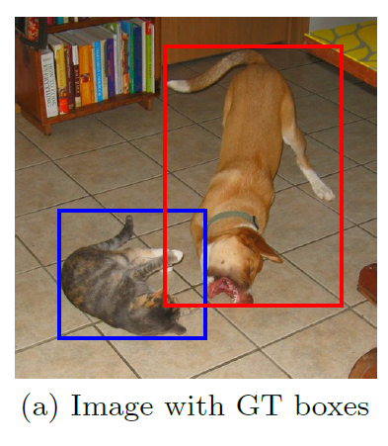
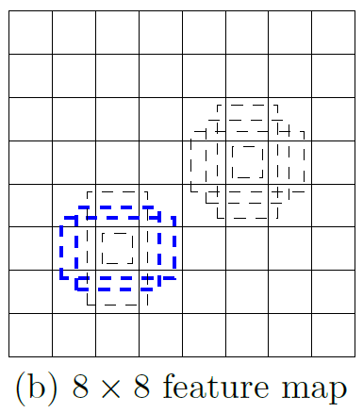
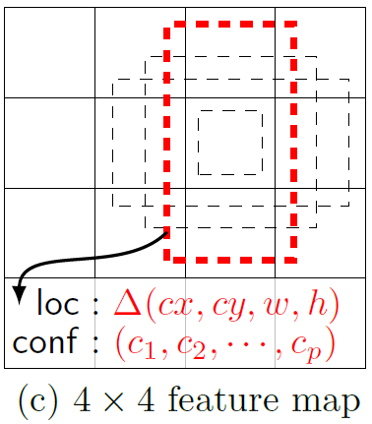
Single Shot MultiBox Detector
74% mAP (mean Average Precision) at 59 frames per second on standard datasets such as PascalVOC and COCO
Single Shot: The tasks of object localization and classification are done in a single forward pass of the network
MultiBox: the name of a technique for bounding box regression, developed by Szegedy et al.
Detector: The network is an object detector that also classifies those detected objects
(from SSD paper)

Slide 27
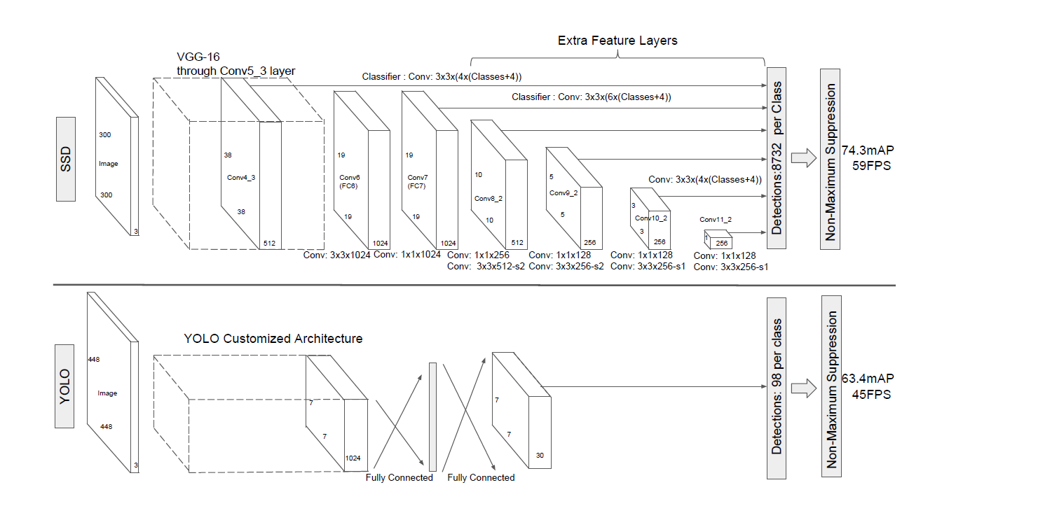
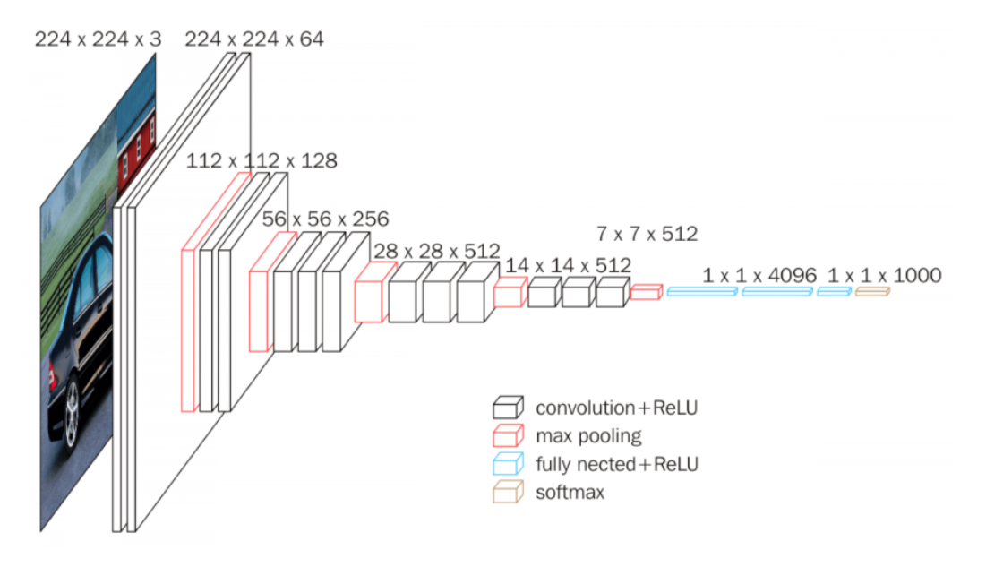
Architecture
SSD and YOLO architecture (from SSD paper)
VGG-16 architecture (from Neurohive)
Notes:
VGG-16 נבחרה בגלל יעילות אבל הופרדה משכבות מחוברות לחלוטין לשכבות עזר בממדים שונים

Slide 28
References
Understanding SSD MultiBox — Real-Time Object Detection In Deep Learning by Eddie Forson, Nov 18, 2017
Click to edit Bullet Point
Click to edit Bullet Point
Click to edit Bullet Point
Click to edit Bullet Point
Click to edit Bullet Point

Slide 29
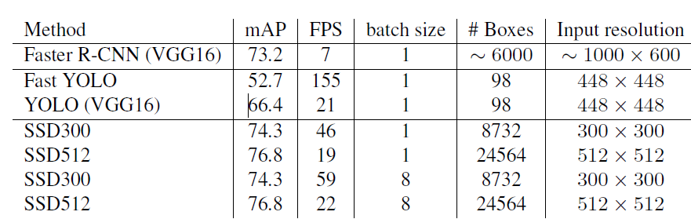
מה עוד
תהליך אימון?
סינון תוצאות עם כמות התאמות גדולה?
מתמטיקה?
תוצאות על המאגרים השונים?
תיאור של ההשוואה בין מולטי בוקס לSSD?
דוגמאות
נקודות תורפה שנשארו במערכת?
Click to edit Bullet Point
Click to edit Bullet Point
Click to edit Bullet Point
Click to edit Bullet Point
Click to edit Bullet Point

Slide 30

Thank you.

Slide 31
Text slide
Click to edit Bullet Point
Click to edit Bullet Point
Click to edit Bullet Point
Click to edit Bullet Point
Click to edit Bullet Point
Click to edit Bullet Point

Slide 32
Text slide
Subtitle
Click to edit Bullet Point
Click to edit Bullet Point
Click to edit Bullet Point
Click to edit Bullet Point
Click to edit Bullet Point
Click to edit Bullet Point

Slide 33

Text + Picture
Click to edit Bullet Point
Click to edit Bullet Point
Click to edit Bullet Point
Click to edit Bullet Point
Click to edit Bullet Point
Click to edit Bullet Point

Slide 34
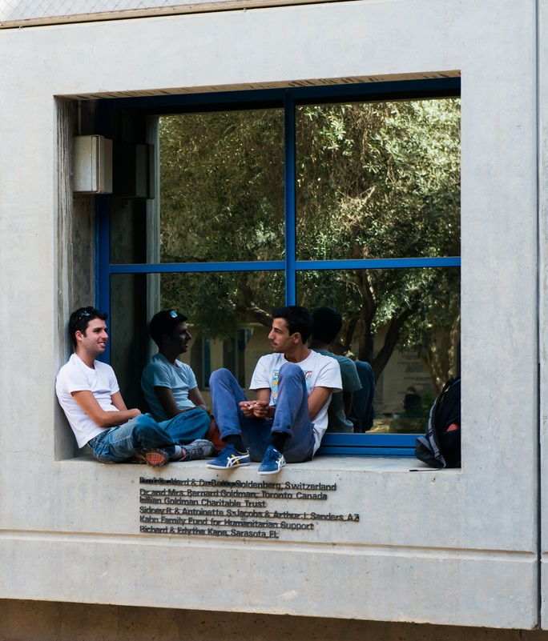
Text + Picture 2
Click to edit Bullet Point
Click to edit Bullet Point
Click to edit Bullet Point
Click to edit Bullet Point
Click to edit Bullet Point
Click to edit Bullet Point

Slide 35

Text + Picture 3
Click to edit Bullet Point
Click to edit Bullet Point
Click to edit Bullet Point
Click to edit Bullet Point
Click to edit Bullet Point
Click to edit Bullet Point

Slide 36

Text + Picture 4

Slide 37
Graph slide

Slide 38
Graph slide
Click to edit Bullet Point
Click to edit Bullet Point
Click to edit Bullet Point
Click to edit Bullet Point
Click to edit Bullet Point
Click to edit Bullet Point
Graph title

Slide 39
Icon bank

Slide 40
Icon bank

